Slide 1
Lecture 23 – In-class worksheet and MIPS reference example
2017.10.13

Slide 2
We had an in-class discussion
Worksheet and solution discussion posted alongside PowerPoint slides here on Blackboard

Slide 3
MIPS fetch-execute example
More detailed than Chapter 6 and Figure 6.9, but similar, overall. Read through this to test and clarify your understanding.

Slide 4
Data path for MIPS register-to-register instruction type
I[x - y] = bits x through y of the Instruction
RegWrite
Read
address
I [25 - 21]
Read
Reg. 1
Reg. 1
data out
ALU
I [31-0] instr. out
Zero?
I [20 - 16]
Read
Reg. 2
Result
Reg. 2
data out
Instruction
memory
I [15 - 11]
Write
Reg.
Register Unit
ALUOp
Write Reg
Data in
No access (read or write) made of the Data Memory by register-to-register type instructions, so Data Memory is not shown in this data path schematic

Slide 5
Control of the data path
Control unit generates all control signals
Input is the 32-bit instruction word
Outputs are blue control signals in schematics
Most control signals = f( opcode )
To illustrate control signals, consider register-register, load, store, and beq (branch if equal) instructions

Slide 6
Control signal table
Operation | RegDst | RegWrite | ALUSrc | ALUOp | MemWrite | MemRead | MemToReg
add | 1 | 1 | 0 | 010 | 0 | 0 | 0
sub | 1 | 1 | 0 | 110 | 0 | 0 | 0
and | 1 | 1 | 0 | 000 | 0 | 0 | 0
or | 1 | 1 | 0 | 001 | 0 | 0 | 0
slt | 1 | 1 | 0 | 111 | 0 | 0 | 0
load | 0 | 1 | 1 | 010 | 0 | 1 | 1
store | X | 0 | 1 | 010 | 1 | 0 | X
beq | X | 0 | 0 | 110 | 0 | 0 | X
store and beq are the only instructions that do not write any registers
load and store use the ALU to compute the effective memory address
ALUOp (ALU operation) for register-register instructions depends on the function field of the instruction (re-purposed bits from unused offset field)
The PCSrc multiplexer control signal (not listed in the table) should be set if the instruction is beq and the ALU Zero output is true

Slide 7
Generating control signals
The control unit needs 13 input bits
Six bits from instruction opcode
Six bits come from instruction function field
1 bit is the “Zero?” output of the ALU
Control unit generates 10 bits of output, corresponding to the signals mentioned on the previous page.
Build the actual circuit by using big K-maps or Boolean algebra
RegDst
RegWrite
Read
address
Instruction
[31-0]
I [31 - 26]
ALUSrc
ALUOp
3
/
I [5 - 0]
Control
MemWrite
Instruction
memory
MemRead
MemToReg
PCSrc
Zero

Slide 8
MIPS load word (lw) instr. data path & key control signals
RegWrite
Read
address
Instruction
[31-0]
I [25 - 21]
MemWrite
MemToReg
Read
register 1
Read
data 1
I [20 - 16]
ALU
Zero
Read
address
Read
data
1
M
u
x
0
Instruction
memory
Read
register 2
0
M
u
x
1
Read
data 2
0
M
u
x
1
Result
Write
address
Write
register
Write
data
Data
memory
I [15 - 11]
Write
data
Registers
ALUOp
RegDst
= 0
ALUSrc
= 1
MemRead
I [15 - 0]
Sign
extend
What do the red data path and red control signals do for lw? Answer: Select the base address register, then sign extend the offset field, set the mux to pass the offset value to the ALU to add (according to ALUOp) to the base address value to produce the desired memory address at the output of the ALU, address data memory with this address, retrieve (read) the value in memory at the named location, set the mux to pass the value from Data memory to the Write data input of the register file to be written into the destination register.

Slide 9
MIPS load word (lw) instr. data path & key control signals
RegWrite
Read
address
Instruction
[31-0]
I [25 - 21]
MemWrite
MemToReg
Read
register 1
Read
data 1
I [20 - 16]
ALU
Zero
Read
address
Read
data
1
M
u
x
0
Instruction
memory
Read
register 2
0
M
u
x
1
Read
data 2
0
M
u
x
1
Result
Write
address
Write
register
Write
data
Data
memory
I [15 - 11]
Write
data
Registers
ALUOp
RegDst
= 0
ALUSrc
MemRead
I [15 - 0]
Sign
extend
What do the black data paths and the blue control signals do for lw? Answer: The black data path lines will be carrying logic signals, but by the way the muxes are set by their control lines, Read data 2 will not reach the ALU and the ALU Result will not be selected to be sent to the Write data input of the Register file. Also, the MemWrite blue control signal will be set by the control logic to not ask the Data memory to write at the same time that it needs to be read to carry out that step of the lw instruction.

Slide 10
Steps in beq (branch if equal)
1. Fetch instruction, say, beq $t0, $s0, offset
2. Read source registers, $t0 and $s0, from register file
3. Compare $t0 and $s0 by subtracting them in the ALU
4. If result is 0, then source operands were equal and PC should be loaded with target address, PC+4+(offset x 4)
5. Else the branch should not be taken, and PC ← PC + 4 to fetch the next sequential instruction

Slide 11
beq $t0, $s0, offset execution: compare regs
Current instruction
fetch address, PC
Zero=1=PCSrc means register comparison found “reg contents are equal” thus branch should be taken, so fetch next instruction at branch target address.
Zero=0=PCSrc means fetch default next instruction
0
M
u
x
1
Add
PC
4
Add
Branch
Shift
left 2
PCSrc
RegWrite
Read
address
Instruction
[31-0]
I [25 - 21]
MemWrite
MemToReg
Read
register 1
Read
data 1
I [20 - 16]
ALU
Zero
Read
address
Read
data
1
M
u
x
0
Instruction
memory
Read
register 2
Read
data 2
0
M
u
x
1
0
M
u
x
1
Result
Write
address
Write
register
Data
memory
I [15 - 11]
Registers
Write
data
Write
data
ALUOp
ALUSrc
MemRead
RegDst
I [15 - 0]
Sign
extend

Slide 12
beq execution: next instr. fetch addr. computation
Mux_0 selected causes next instruction fetch at default address; Mux_1 selected causes fetch next instruction at branch target address
Additional adder to compute effective addr. because ALU subtracting to compare registers
Actual next instruction address as selected by Mux
PC+4 serves as register containing a Base Address
0
M
u
x
1
Add
PC+4 default next instruction address
PC
4
Add
Base Address + Offset is (PC+4)+(offset×4)
Shift
left 2
PCSrc
RegWrite
offset×4
Read
address
Instruction
[31-0]
I [25 - 21]
MemWrite
MemToReg
Read
register 1
Read
data 1
I [20 - 16]
ALU
Read
address
Read
data
1
M
u
x
0
Instruction
memory
Read
register 2
Zero
0
M
u
x
1
Read
data 2
0
M
u
x
1
Result
Write
address
Write
register
Data
memory
I [15 - 11]
Registers
Write
data
Write
data
ALUOp
ALUSrc
MemRead
RegDst
Offset field
I [15 - 0]
Sign
extend

Slide 13
Pipelining the MIPS circuit
Use in comparison to the processor circuit of Figure 6.9.

Slide 14
Example ISA: MIPS (text Fig. 5.9)
MIPS – acronym for Microprocessor without Interlocked Pipeline Stages
Principles: speed and minimalism
Just 32 instructions, a 5-bit string can name all instructions with no waste
One register devoted to holding the number 0
Orthogonality – each instruction performs a unique task
Easier for compiler to generate good assembly code

Slide 15
Instruction processing steps
Step | Name | Description
Instruction Fetch | IF | Read an instruction from memory
Instruction Decode | ID | Decode instr., read registers, sign extend offset, and generate control signals
Execute | EX | Compute needed result
Memory | MEM | Read or write the data memory
Write Back | WB | Write a result into the destination register

Slide 16
Step 1: Instruction Fetch (IF)
Use Current_PC to address instruction memory and compute Default_next_PC
Add
4
PC
RegWrite
Read
address
Instruction
[31-0]
I [25 - 21]
MemWrite
MemToReg
Read
register 1
Read
data 1
I [20 - 16]
ALU
Read
address
Read
data
1
M
u
x
0
Instruction
memory
Read
register 2
Zero
0
M
u
x
1
Read
data 2
0
M
u
x
1
Result
Write
address
Write
register
Data
memory
Registers
Write
data
I [15 - 11]
Write
data
ALUOp
ALUSrc
MemRead
RegDst
I [15 - 0]
Sign
extend

Slide 17
Step 2: Instruction Decode (ID)
Decode instruction fields, read registers to obtain operands, sign extend offset field, and (not shown) send opcode field to inputs of Boolean control logic circuit to generate all “blue” control signals
RegWrite
Read
address
Instruction
[31-0]
I [25 - 21]
MemWrite
MemToReg
Read
register 1
Read
data 1
I [20 - 16]
ALU
Read
address
Read
data
1
M
u
x
0
Instruction
memory
Read
register 2
Zero
0
M
u
x
1
Read
data 2
0
M
u
x
1
Result
Write
address
Write
register
Data
memory
Registers
Write
data
I [15 - 11]
Write
data
ALUOp
ALUSrc
MemRead
RegDst
I [15 - 0]
Sign
extend

Slide 18
Step 3: Execute (EX)
Compute required value; here the red highlights computing an effective address by adding Read data 1 register (holds the base address) to the instruction offset field (addition would be specified via the ALUOp control lines)
RegWrite
Read
address
Instruction
[31-0]
I [25 - 21]
MemWrite
MemToReg
Read
register 1
Read
data 1
I [20 - 16]
ALU
Read
address
Read
data
1
M
u
x
0
Instruction
memory
Read
register 2
Zero
0
M
u
x
1
Read
data 2
0
M
u
x
1
Result
Write
address
Write
register
Data
memory
Registers
Write
data
I [15 - 11]
Write
data
ALUOp
ALUSrc
MemRead
RegDst
I [15 - 0]
Sign
extend

Slide 19
Step 4: Memory access (MEM)
Read or write data memory, if required, using the address computed by the ALU
RegWrite
Read
address
Instruction
[31-0]
I [25 - 21]
MemWrite
MemToReg
Read
register 1
Read
data 1
I [20 - 16]
ALU
Read
address
Read
data
1
M
u
x
0
Instruction
memory
Read
register 2
Zero
0
M
u
x
1
Read
data 2
0
M
u
x
1
Result
Write
address
Write
register
Data
memory
Registers
Write
data
I [15 - 11]
Write
data
ALUOp
ALUSrc
MemRead
RegDst
I [15 - 0]
Sign
extend

Slide 20
Step 5: Write back (WB)
Write the result from EX or MEM, if there is a result, into the destination register (red lines here show the result coming from a read access of data memory)
Not all instructions generate a result to save in a register in the register file: store puts its result into data memory; and branch puts its result into the PC register
RegWrite
Read
address
Instruction
[31-0]
I [25 - 21]
MemWrite
MemToReg
Read
register 1
Read
data 1
I [20 - 16]
ALU
Read
address
Read
data
1
M
u
x
0
Instruction
memory
Read
register 2
Zero
0
M
u
x
1
Read
data 2
0
M
u
x
1
Result
Write
address
Write
register
Data
memory
Registers
Write
data
I [15 - 11]
Write
data
ALUOp
ALUSrc
MemRead
RegDst
I [15 - 0]
Sign
extend

Slide 21
Not all instructions need all steps
Instruction Type | Steps required
Branch (beq) | IF | ID | EX
Register-register | IF | ID | EX |  | WB
Store (sw) | IF | ID | EX | MEM
Load (lw) | IF | ID | EX | MEM | WB
Only Load makes use of the entire circuit
Further, each step is used once as signals propagate through the circuit, so a lot of gates are holding their outputs fixed for the long time needed to propagate to the very end (WB step)
Gates should be asked to do new logic computations often because when gates compute they make progress with our program

Slide 22
Using idle parts of the circuit
Perhaps we do not have to wait for an instruction to complete before giving new work to early (upstream) functional units
For example, instruction memory is idle during the Instruction Decode step as shown below, so...
Idle
Instruction Decode (ID)
RegWrite
Read
address
Instruction
[31-0]
I [25 - 21]
MemWrite
MemToReg
Read
register 1
Read
data 1
I [20 - 16]
ALU
Read
address
Read
data
1
M
u
x
0
Instruction
memory
Read
register 2
Zero
0
M
u
x
1
Read
data 2
0
M
u
x
1
Result
Write
address
Write
register
Data
memory
Registers
Write
data
I [15 - 11]
Write
data
ALUOp
ALUSrc
MemRead
RegDst
I [15 - 0]
Sign
extend

Slide 23
Overlap two instructions
Fetch 2nd instruction
Decode 1st instruction of program
RegWrite
Read
address
Instruction
[31-0]
I [25 - 21]
MemWrite
MemToReg
Read
register 1
Read
data 1
I [20 - 16]
ALU
Read
address
Read
data
1
M
u
x
0
Instruction
memory
Read
register 2
Zero
0
M
u
x
1
Read
data 2
0
M
u
x
1
Result
Write
address
Write
register
Write
data
Data
memory
I [15 - 11]
Write
data
Registers
ALUOp
ALUSrc
MemRead
RegDst
I [15 - 0]
Sign
extend

Slide 24
Continue overlapping
Fetch 3rd
Decode 2nd
Execute 1st
RegWrite
Read
address
Instruction
[31-0]
I [25 - 21]
MemWrite
MemToReg
Read
register 1
Read
data 1
I [20 - 16]
ALU
Read
address
Read
data
1
M
u
x
0
Instruction
memory
Read
register 2
Zero
0
M
u
x
1
Read
data 2
0
M
u
x
1
Result
Write
address
Write
register
Write
data
Data
memory
I [15 - 11]
Write
data
Registers
ALUOp
ALUSrc
MemRead
RegDst
I [15 - 0]
Sign
extend

Slide 25
Create a pipelined datapath
IF
ID
EXE
MEM
WB
RegWrite
Read
address
Instruction
[31-0]
I [25 - 21]
MemWrite
MemToReg
Read
register 1
Read
data 1
I [20 - 16]
ALU
Read
address
Read
data
1
M
u
x
0
Instruction
memory
Read
register 2
Zero
0
M
u
x
1
Read
data 2
0
M
u
x
1
Result
Write
address
Write
register
Write
data
Data
memory
I [15 - 11]
Write
data
Registers
ALUOp
ALUSrc
MemRead
RegDst
I [15 - 0]
Sign
extend

Slide 26
Pipelined execution
Example of pipelining a sequence of load word (lw) instructions
Assume that each step of IF, ID, EX, MEM, WB takes 1 clock cycle
 | Clock cycle (time advances in this direction →)
 | 1 | 2 | 3 | 4 | 5 | 6 | 7 | 8 | 9
lw $t0, 4($sp) | IF | ID | EX | MEM | WB
lw $t1, 8($sp) |  | IF | ID | EX | MEM | WB
lw $t2, 12($sp) |  |  | IF | ID | EX | MEM | WB
lw $t3, 16($sp) |  |  |  | IF | ID | EX | MEM | WB
lw $t4, 20($sp) |  |  |  |  | IF | ID | EX | MEM | WB

Slide 27
Pipeline performance
Emptying pipeline stages
 | Clock cycle
 | 1 | 2 | 3 | 4 | 5 | 6 | 7 | 8 | 9
lw $t0, 4($sp) | IF | ID | EX | MEM | WB
lw $t1, 8($sp) |  | IF | ID | EX | MEM | WB
lw $t2, 12($sp) |  |  | IF | ID | EX | MEM | WB
lw $t3, 16($sp) |  |  |  | IF | ID | EX | MEM | WB
lw $t4, 20($sp) |  |  |  |  | IF | ID | EX | MEM | WB
Filling pipeline stages,
Pipeline startup time
Ideal instruction
processing overlap
Execution time on pipeline
Faster clock cycle possible due to smaller propagation delay through slowest stage, rather than of slowest path through entire circuit
Ideal execution time for a program = Pipeline startup time + one cycle per instruction thereafter

Slide 28
Pipelining a mix of instruction types
R-type instructions only require 4 stages: IF, ID, EX, and WB; do not need MEM stage
What happens with mix of loads & R-type instructions?
In this example, WB stage hardware is needed by two different instructions at same time to write two results
Designer must ask is this both feasible and desirable? The answer may be NO
 | Clock cycle
 | 1 | 2 | 3 | 4 | 5 | 6 | 7 | 8 | 9
add $sp, $sp, -4 | IF | ID | EX | WB
sub $v0, $a0, $a1 |  | IF | ID | EX | WB
lw $t0, 4($sp) | ------- | ----→ | IF | ID | EX | MEM | WB
or $s0, $s1, $s2 | ------- | ------- | ----→ | IF | ID | EX | WB
lw $t1, 8($sp) |  |  |  |  | IF | ID | EX | MEM | WB

Slide 29
Important observations of MIPS design
Each functional unit used only once per instr.
Functional units must be used in the same sequence for all instructions, disallow:
Load uses Register File write port during its 5th step
R-type uses Register File write port during its 4th step
 | Clock cycle
 | 1 | 2 | 3 | 4 | 5 | 6 | 7 | 8 | 9
add $sp, $sp, -4 | IF | ID | EX | WB
sub $v0, $a0, $a1 |  | IF | ID | EX | WB
lw $t0, 4($sp) |  |  | IF | ID | EX | MEM | WB
or $s0, $s1, $s2 |  |  |  | IF | ID | EX | WB
lw $t1, 8($sp) |  |  |  |  | IF | ID | EX | MEM | WB
Two instructions need same stage at the same time

Slide 30
One solution: insert NOP steps
NOP = no operation (do nothing)
Make all instructions take 5 steps (clock cycles)
Make them have the same steps, in the same order
Some stages will do nothing for some instructions
Stores and Branches have NOP stages, too
R-type | IF | ID | EX | NOP | WB
 | Clock cycle
 | 1 | 2 | 3 | 4 | 5 | 6 | 7 | 8 | 9
add $sp, $sp, -4 | IF | ID | EX | NOP | WB
sub $v0, $a0, $a1 |  | IF | ID | EX | NOP | WB
lw $t0, 4($sp) |  |  | IF | ID | EX | MEM | WB
or $s0, $s1, $s2 |  |  |  | IF | ID | EX | NOP | WB
lw $t1, 8($sp) |  |  |  |  | IF | ID | EX | MEM | WB
store | IF | ID | EX | MEM | NOP
branch | IF | ID | EX | NOP | NOP

Slide 31
Need for stage interface registers
Add interface registers to pipeline the datapath
One big register to hold the output bit string from each stage
These registers are named for the stages they interface
IF/ID ID/EX EX/MEM MEM/WB
No register is needed after the WB stage, because after WB the instr. is complete

Slide 32
Pipelined datapath
1
0
PCSrc
4
IF/ID
ID/EX
EX/MEM
MEM/WB
P C
Add
Add
RegWrite
Shift left 2
Read register 1
Read register 2
Write register
Write
Read data 1
Read data 2
Read Instruction address [31-0]
Instruction memory
MemWrite
^{ALU} Zero
Result
0
Address
1
Data memory
MemToReg
Registers
ALUOp
data
ALUSrc
Write data
Read data
1
Instr [15 - 0]
Sign extend
RegDst
MemRead
0
Instr [20 - 16]
Instr [15 - 11]
0
1

Slide 33
Propagating values through the pipeline
Information required in later stages must be propagated through the pipeline via the interface registers
Consider the destination register field in the instruction
The rd field of the instruction word, retrieved in the first stage (IF), determines the destination register, but that register is written in the last stage (WB)
Thus, rd field must pass through all pipeline stages, shown in red on next slide, so register file can be properly addressed at the time to write to rd

Slide 34
Path of destination register field bits (red)
1
0
PCSrc
4
IF/ID
ID/EX
EX/MEM
MEM/WB
P C
Add
Add
RegWrite
Shift left 2
I [25-21]
Read register 1
Read register 2
Write register
Write
Read data 1
Read data 2
Read Instruction address [31-0]
Instruction memory
I [20-16]
MemWrite
^{ALU} Zero
Result
0
Address
1
Data memory
MemToReg
Registers
ALUOp
data
ALUSrc
Write data
Read data
1
Instr [15 - 0]
Sign extend
RegDst
MemRead
0
Instr [20 - 16]
Instr [15 - 11]
0
1
Mux circuit moved to first stage to receive its computed control signal

Slide 35
Pipelining control signals
Control signals computed as part of instruction decoding, then passed
along for use as needed, just like instruction fields are passed along
1
0
ID/EX
PCSrc
Instr [31-26, 5-0]
WB
EX/MEM
Control
M
WB
MEM/WB
4
IF/ID
EX
M
WB
P C
Add
Add
RegWrite
Shift left 2
I [25-21]
Read register 1
Read register 2
Write register
Write
Read data 1
Read data 2
Read Instruction address [31-0]
Instruction memory
I [20-16]
MemWrite
^{ALU} Zero
Result
0
Address
1
Data memory
MemToReg
Registers
ALUOp
data
ALUSrc
Write data
Read data
1
Instr [15 - 0]
Sign extend
RegDst
MemRead
0
Instr [20 - 16]
Instr [15 - 11]
0
1

Slide 36
MIPS detailed example execution sequence
Here’s a sample sequence of instructions to execute
1000: lw $8, 4($29)
1004: | sub | $2, $4, $5
1008: | and | $9, $10, $11
100C: | or | $16, $17, $18
1010: | add | $13, $14, $0
Pipeline diagrams in the next slides follow these notational conventions
??? indicates unknown values, usually resulting from instructions coming before and after the ones in the above code snippet
$8 indicates register number 8
4 represents an immediate value, that is, a constant available from an instruction field (no separate data fetch required)
X indicates don’t care, e.g., offset field of an R-type instruction
Assumptions (so data values can be seen and tracked from stage to stage)
Each register contains a value equal to its number name plus 100 For instance, register $8 contains 108, register $29 contains 129
Every data memory location contains the value 99

Slide 37
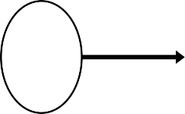


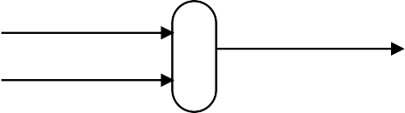
Cycle 1 (starting to fill the pipeline)
IF: lw $8, 4($29)
ID: ???
EX: ???
MEM: ???
WB: ???
1004
1
0
ID/EX
WB
EX/MEM
PCSrc=0
Control
M
WB
MEM/WB
4
IF/ID
EX
M
WB
Add
P C
1004
Add
RegWrite (?)
Shift
left 2
1000
???
Read register 1
Read register 2
??? Write register
Write data
Read data 1
Read ??? data 2
??? ???
MemWrite (?)
Read address
Instruction
[31-0]
???
???
^{ALU} Zero
???
0
Result
Address
???
Data memory
MemToReg (?)
Instruction memory
1
???
Registers
ALUOp (???)
ALUSrc (?)
???
Write data
Read data
???
1
???
Sign extend
???
RegDst (?)
MemRead (?)
???
0
???
???
0
???
???
???
???
???
1
???

Slide 38
Cycle 2
IF: sub $2, $4, $5
ID: lw $8, 4($29)
EX: ???
MEM: ???
WB: ???
1008
1
0
ID/EX
WB
EX/MEM
WB
PCSrc=0
Control
M
WB
MEM/WB
WB
IF/ID
EX
M
4
M
Add
1004
P C
1008
Add
RegWrite (?)
Shift
left 2
[25-21]=29
Read register 1
Read register 2
Write register
Write data
Read data 1
Read data 2
129
???
1004
MemWrite (?)
Read address
Instruction
[31-0]
[20-16]=8
100
???
^{ALU} Zero
???
0
Result
Address
[15-11]=?
???
Data memory
MemToReg (?)
Instruction memory
1
Registers
ALUOp (???)
???
ALUSrc (?)
???
Write data
Read data
1
[15-0]=Offset = 4
Sign
4
???
RegDst (?)
???
extend
MemRead (?)
0
Instr[20-16] = 8
???
0
???
???
???
Instr[15-11] = 0
???
1
???

Slide 39
Cycle 3
IF: and $9, $10, $11
ID: sub $2, $4, $5
EX: lw $8, 4($29)
MEM: ???
WB: ???
100C
1
0
ID/EX
WB
EX/MEM
WB
PCSrc=0
Control
M
WB
MEM/WB
WB
IF/ID
EX
M
4
M
Add
1014
P C
100C
1008
1004
Add
Shift
16
RegWrite (?)
left 2
1008
4
Read register 1
Read register 2
??? Write register
Write data
Read data 1
Read data 2
104
129
0
MemWrite (?)
Read address
Instruction
[31-0]
5
105
100
^{ALU} Zero?
???
0
Result
Address
4
133
1
Data memory
MemToReg (?)
Instruction memory
???
Registers
ALUOp (+ )
)
ALUSrc (1
???
Write data
Read data
???
1
100
X
Sign extend
X
4
RegDst (1 )
MemRead (?)
???
0
5
8
0
8
???
???
2
0
1
???

Slide 40
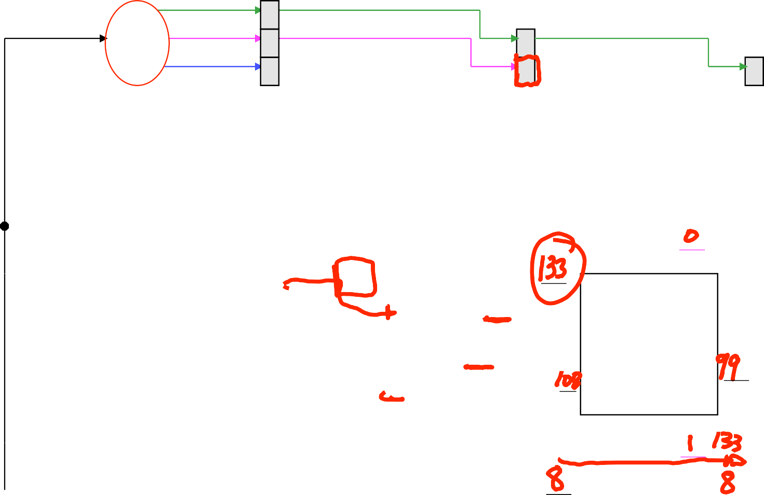
Cycle 4
IF: or $16, $17, $18
ID: and $9, $10, $11
EX: sub $2, $4, $5
MEM: lw $8, 4($29)
WB: ???
100F
1
1014
0
ID/EX
WB
EX/MEM
WB
PCSrc=0
Control
M
MEM/WB
WB
4
IF/ID
EX
M
Add
1008
X
P C
100F
100C
Add
Shift
X
RegWrite (?)
left 2
100C
10
Read register 1
Read register 2
??? Write register
Write data
Read data 1
Read data 2
110
104
MemWrite ( )
Read address
Instruction
[31-0]
11
111
105
^{ALU} Zero
0
Result
Address
–1
MemToReg (?)
Instruction memory
1
Data memory
???
Registers
ALUOp (sub)
ALUSrc (0)
100
Write data
Read data
???
1
X
Sign extend
X
RegDst (1)
MemRead ( )
???
0
11
5 2
0
2
???
9
1
???

Slide 41
Cycle 5 (pipeline is now full)
IF: add $13, $14, $0
ID: or $16, $17, $18
EX: and $9, $10, $11
MEM: sub $2, $4, $5
WB:
lw $8, 4($29)
1014
1
X
0
ID/EX
WB
EX/MEM
PCSrc
Control
M
WB
MEM/WB
4
IF/ID
EX
M
WB
Add
100C
P
1014
100F
Add
X
C
Shift
X
RegWrite ( )
left 2
100F
17
Read register 1
Read register 2
Write register
Write data
Read data 1
Read data 2
117
110
MemWrite (0)
Read address
Instruction
[31-0]
18
118
111
^{ALU} Zero
-1
0
111
Result
Address
8
110
MemToReg ( 1 )
Instruction memory
1
Data memory
99
Registers
ALUOp (and)
99
ALUSrc (0)
105 Write
data
Read data
X
1
X
Sign extend
X
RegDst (1)
133
MemRead (0)
₀
18
11 9
0
9
2
16
1

Slide 42

Cycle 6 (start to empty pipeline)
IF: ???
ID: add $13, $14, $0 EX: or $16, $17, $18
MEM: and $9, $10, $11
WB: sub
$2, $4, $5
1
0
ID/EX
WB
EX/MEM
PCSrc
Control
M
WB
MEM/WB
4
IF/ID
EX
M
WB
Add
P C
???
Add
RegWrite
(1)
Shift
left 2
14
114
117
1020
Read
Read
register 1
Read register 2
Write register
Write data
data 1
Read data 2
MemWrite (0)
Read address
Instruction
[31-0]
0
0
118
^{ALU} Zero
110
0
Result
Address
2
119
Data memory
MemToReg
Instruction memory
-1
1
(0)
Registers
ALUOp (or)
ALUSrc
(0)
111 Write
data
Read data
X
1
Sign extend
X
RegDst (1)
MemRead (0)
0
0
18
0
16
9
13
16
1

Slide 43
Cycle 7
IF: ???
ID: ???
EX: add $13, $14, $0
MEM: or $16, $17, $18
WB: and
$9, $10, $11
1
0
ID/EX
WB
EX/MEM
PCSrc
Control
M
WB
MEM/WB
4
IF/ID
EX
M
WB
Add
P C
???
Add
RegWrite (1)
Shift
left 2
???
???
Read register 1
Read register 2
9 Write register
Write data
Read data 1
Read data 2
???
114
MemWrite (0)
Read address
Instruction
[31-0]
???
???
0
^{ALU} Zero
119
0
Result
Address
1
114
Data memory
MemToReg (0)
Instruction memory
110
Registers
ALUOp (add)
ALUSrc (0)
118 Write
data
Read data
X
X
1
???
Sign extend
X
RegDst (1)
MemRead (0)
110
0
???
0 13
0
13
16
9
???
1
110

Slide 44
Cycle 8
IF: ???
ID: ???
EX: ???
MEM: add $13, $14, $0
WB: or $16,
$17, $18
1
0
ID/EX
WB
EX/MEM
PCSrc
Control
M
WB
MEM/WB
4
IF/ID
EX
M
WB
Add
P C
???
Add
RegWrite (1)
Shift
left 2
???
???
Read register 1
Read register 2
16 Write register
Write data
Read data 1
Read data 2
???
???
MemWrite (0)
Read address
Instruction
[31-0]
???
??? ???
^{ALU} Zero
114
0
Result
Address
1
???
Data memory
MemToReg (0)
Instruction memory
119
Registers
ALUOp (???)
ALUSrc (?)
0 Write data
Read data
X
X
1
???
Sign extend
???
RegDst (?)
MemRead (0)
119
0
???
???
???
???
0
???
13
16
1
119

Slide 45
Cycle 9
IF: ???
ID: ???
EX: ???
MEM: ???
WB: add
$13, $14, $0
1
0
ID/EX
WB
EX/MEM
PCSrc
Control
M
WB
MEM/WB
4
IF/ID
EX
M
WB
Add
P C
???
Add
RegWrite (1)
Shift
left 2
???
???
Read register 1
Read register 2
13 Write register
Write data
Read data 1
Read data 2
???
???
MemWrite (?)
Read address
Instruction
[31-0]
???
??? ???
^{ALU} Zero
???
0
Result
Address
1
???
Data memory
MemToReg (0)
Instruction memory
114
Registers
ALUOp (???)
ALUSrc (?)
? Write data
Read data
X
X
1
???
Sign extend
???
RegDst (?)
MemRead (?)
114
0
???
???
???
???
0
???
???
13
1
114

Slide 46
Pipeline diagram for previous circuit schematics
Clock cycle 5
1
2
3
4
6
7
8
9
lw $t0, 4($sp) sub $v0, $a0, a1
and $t1, $t2, $t3
or $s0, $s1,$s2
add $t5, $t6, $0
Compare the last nine slides with the pipeline diagram above
See how instruction executions are overlapped
Each functional unit is used by a different instruction in each cycle
Pipeline registers forward control and data values generated in ID stage for later use
When the pipeline is full in clock cycle 5, most hardware units are active rather than idle; “(mem)” means the MEM stage is not being used by the instruction, specifically, ALU output is on a bus that bypasses data memory on its way to the WB stage
A full pipeline is the ideal situation
How often is pipeline full? What can stage utilization be increased?
IF | ID | EX | MEM | WB
 | IF | ID | EX | (mem) | WB
 |  | IF | ID | EX | (mem) | WB
 |  |  | IF | ID | EX | (mem) | WB
 |  |  |  | IF | ID | EX | (mem) | WB

Slide 47
Instruction set architectures and pipelining
MIPS ISA designed specifically for easy pipelining
Fixed-length instructions: easiest instruction fetch
Instruction fields are in the same position for all instructions, simplifying ID stage and keeping it fast
MIPS is a register-to-register architecture, so arithmetic operations do not contain memory references; keeps the pipeline shorter and simpler (no need for data memory access(es) before EX stage; no need for multiple data memory accesses by a single instruction)
Pipelining is harder for older, more complex instruction sets
Different length and different format instructions make IF and ID circuits more complex and slower to determine the actual length of each instruction and the positions of the instruction fields
Memory-to-memory arithmetic instructions require memory access before EX so additional pipeline stages may be needed to compute effective addresses and read memory before an instruction is ready for EX stage

Slide 48
Pipelining summary
Pipelining does not improve execution time of any single instruction
Each instruction takes longer to execute than in a single-cycle datapath because of
additional interface register-caused propagation delay
clock frequency based on slowest pipeline stage
All instructions pass through all stages even when not using the capability(ies) of that stage
Pipelining increases throughput, amount of work completed per unit time; multiple instructions are being executed simultaneously
Result is reduced execution time for a sequence of instructions, such as an entire program
Hardware finishes a program sooner when it does more simultaneously
There are many hardware and software techniques to reduce stalls

Slide 49
Lectures 23 – Pipelining
2017.10.16
Follow the yellow brick road.
Follow the yellow brick road.
Follow, follow, follow, follow,
follow the yellow brick road.
– lyrics from The Wizard of Oz
(and what the IF stage must do if we imagine the yellow brick road is the program execution path)

Slide 50
Assignment
Optional Lab 04B due this week; send email
Lab 06 issues this week
Read at least the Amdahl’s Law section of CS250 Synopsis v1.0 which is posted on Blackboard as preparation for Lecture 17

Slide 51
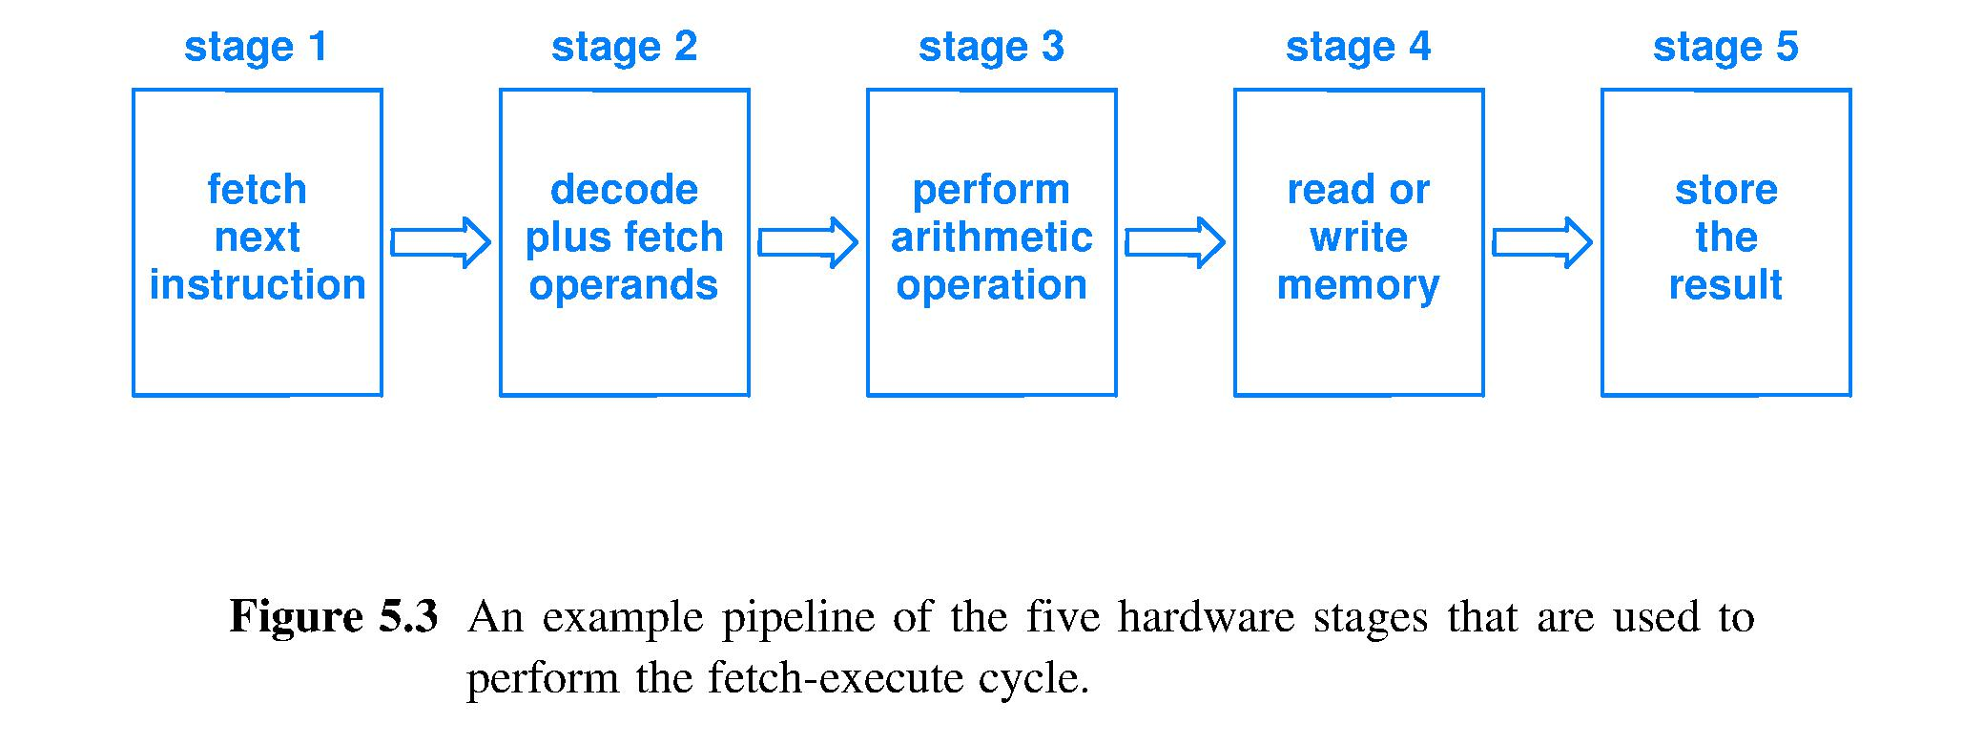
Go faster by being too “lazy” to be slow
Lazy idea: do not complete 1 instruction in 1 clock cycle; be lazy, do less per clock cycle
Split Fetch-Execute cycle into 5 stages that each do “~1/5 the work, but in ~1/5 the time”
If instructions are independent, can fully overlap
Instructions complete up to 5x faster
Fetch – Execute

Slide 52
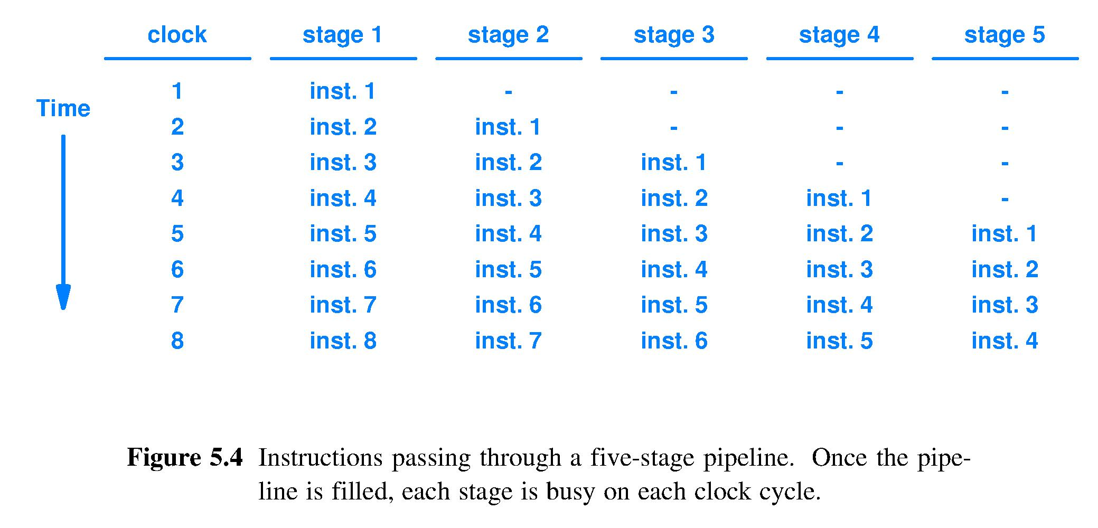
Pipeline activity in space-time
Space (propagation through circuit)
Advancing

Slide 53
Instruction pipeline operation
Pipeline is transparent to programmers because the ISA contains no references to the pipeline structure of the circuit
Seamless instruction overlap in time requires instruction independence
Example with dependence (a.k.a. dependency)
Instruction K: C ← add A B
Instruction K+1: D ← subtract E C
K must complete before K+1 can read operand C

Slide 54
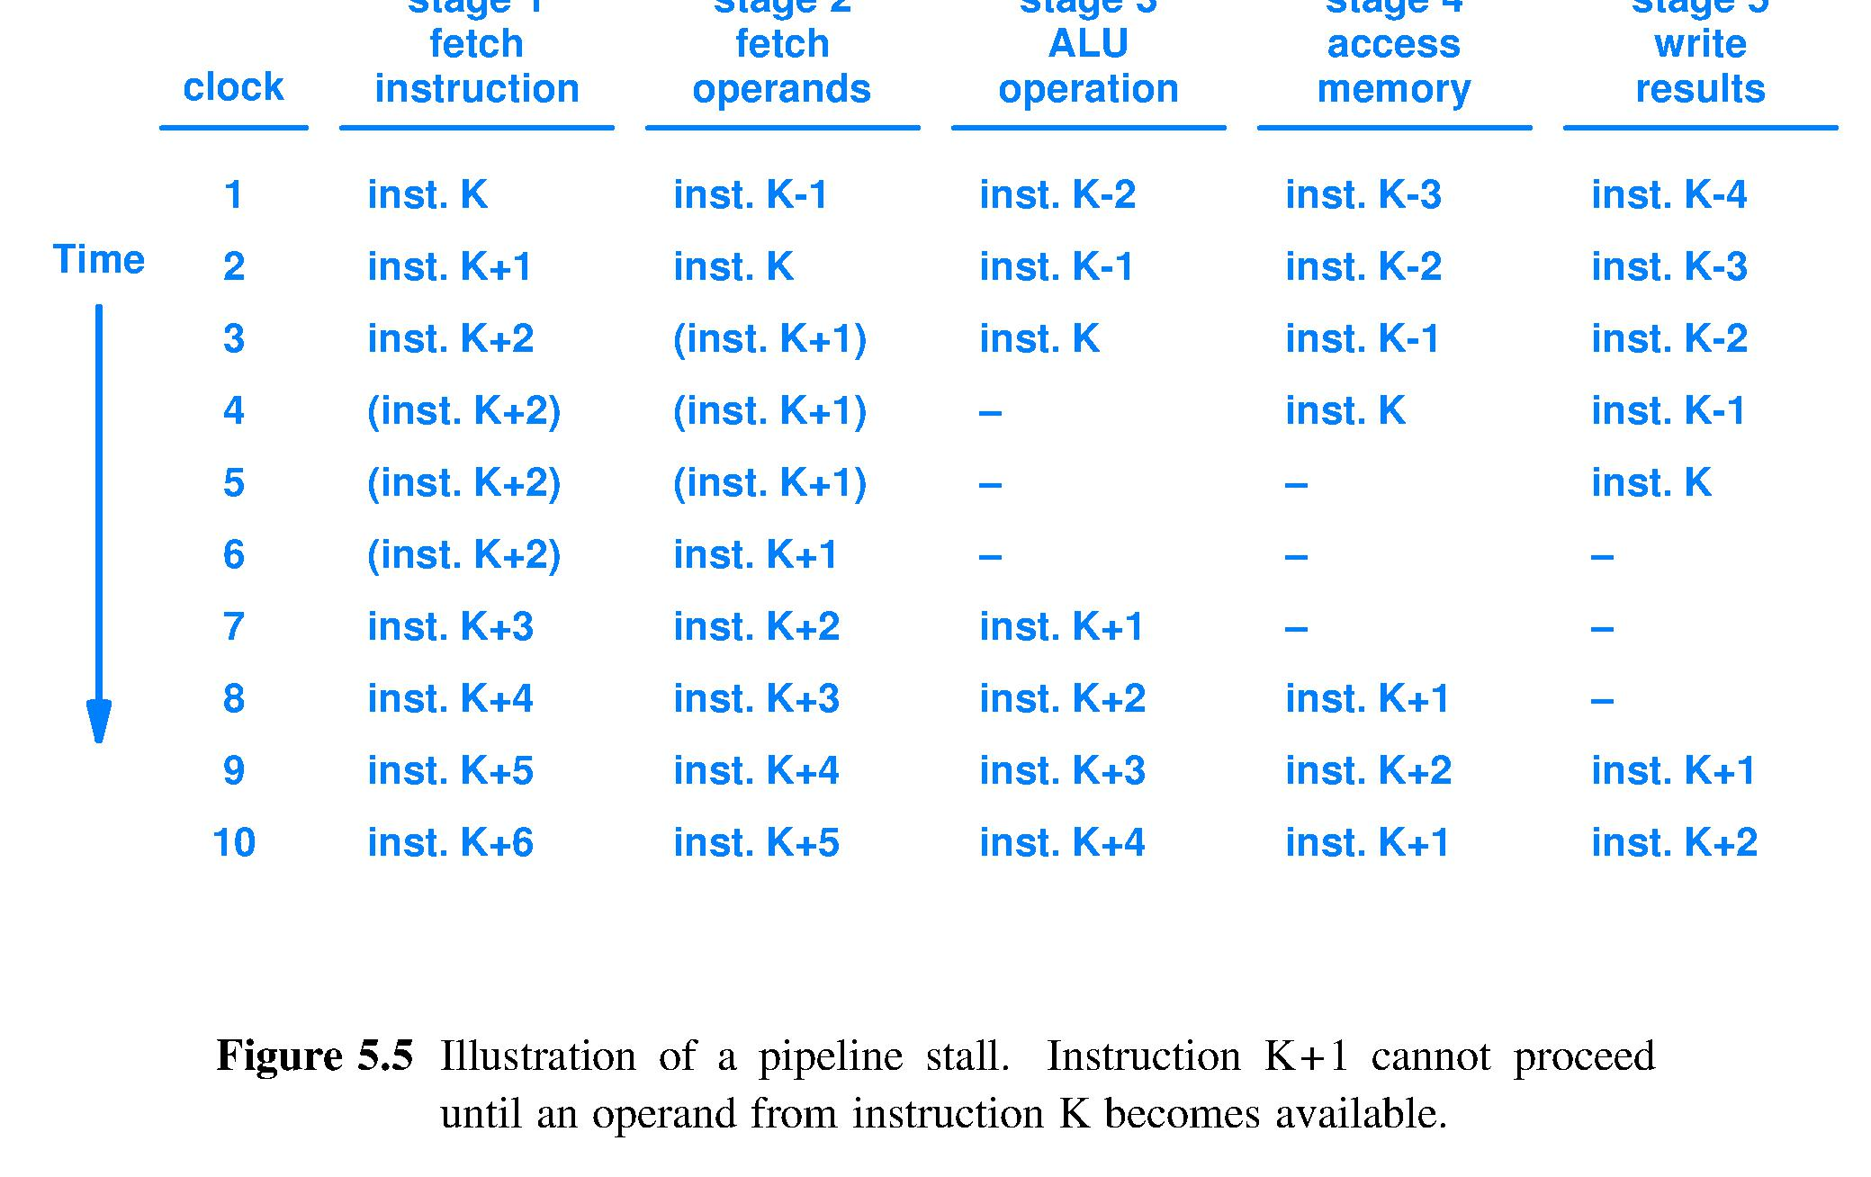
Pipeline stall due to instr. dependence
Inst.?
NOP1
NOP2
NOP1
NOP3
NOP2
NOP1
NOP3
NOP2
NOP3
MUST insert an instruction here, hardware MUST be told what to do; Yet, must NOT change program’s meaning; so ISA intended to be pipelined should be designed to include a NOP instruction; NOP means No OPeration (consume time but have no effects)

Slide 55
Inst. K+1 depends on K; stall until result written and detected (one of many design options)
NOP 1
NOP 2
NOP 1
NOP 2
NOP
NOP
NOP
NOP 3
NOP 1
NOP 3
NOP 2
NOP 3
Stalls filled with NOPs = 3 clocks wasted time = throughput loss
Textbook

Slide 56
Other causes of pipeline stalls
Program accesses a “device” that cannot respond as soon as the CPU pipeline circuit is ready for its response
Pipeline then stalls waiting for a response
By default, pipeline fetches instructions in sequence …, K, K+1, K+2, … Pipeline stalls if next instruction is not next numerically
If-then-else: some instructions must be skipped
Subroutine call: goto new start of new instruction sequence

Slide 57
Hardware designers reducing stalls
Will add considerable circuitry to analyze the fetched stream of instructions, called the path of execution, to
Detect dependences between instructions and re-order the sequence of instructions after their fetch to reduce stalls [Scheduling]
Let an operand be found and fetched from a location other than the location pointed to by the instruction itself [Forwarding]
Guess the truth value of a conditional expression before it is computed and steer the path of execution accordingly, maintaining the ability to clean up after a wrong guess [Speculation]

Slide 58
Compiler writers reducing stalls
Will incorporate much code to analyze the source and optimize the emitted assembly to
Optimize use of general purpose registers [Register allocation]
Reorder assembly instructions to eliminate dependence-caused stalls [Instruction scheduling]
Strive to avoid introducing name dependences [Single assignment]
Perform [branch logic inversion], [operation strength reduction], [loop unrolling], and many more code transformations that yield a faster execution path through the assembly code

Slide 59
ISA instruction grouping schemes
Different groupings emphasize different aspects of an ISA
Left column emphasizes function; right column emphasizes data movement, fetch location and operating mode
Textbook example | Another way
Integer arithmetic | } ^{Register-to-register}
Floating point arithmetic
Logical
Graphics
Data access and transfer | LOAD/STORE
Conditional and unconditional branch | } ^{Control}
Processor control

Slide 60
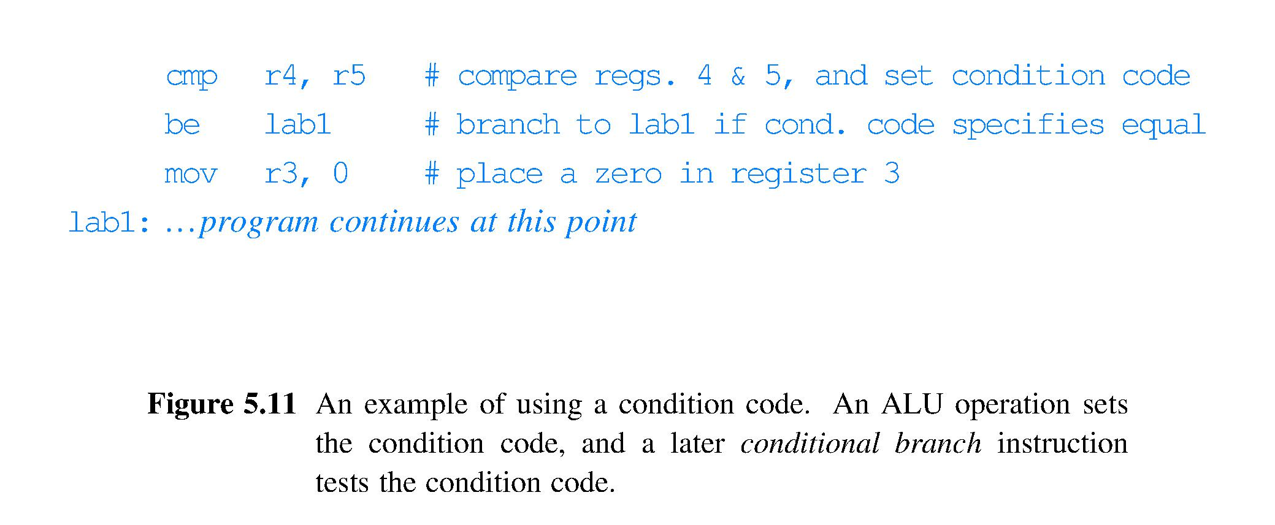
Condition code and conditional branch

Slide 61
Summary (chapter 5)
ISA – set of operations a processor can execute
CISC and RISC ISAs
General purpose registers more than fast enough to keep up with combinatorial logic
Pipelining completes more instructions per second by doing less work per clock cycle per instruction
Pipelines can stall, wasting time; many HW and SW methods to reduce stalls
Condition codes guide conditional execution via conditional branch instructions

Slide 62
What to do about pipeline stalls?
The material in these Lecture 23 slides is supplemental to Chapters 5 and 6 of the text
A better understanding of pipelining via a series of examples of increasingly effective ways to deal with pipeline stalls

Slide 63
Handling pipeline stalls
Observation 1: All instructions fetched later than stalled instruction will also stall
Instructions earlier in the pipeline, instructions “upstream” in the pipeline are fetched later than instructions “downstream” in the pipeline, instructions later in the pipeline
Observation 2: Instructions fetched earlier than stalled instruction must continue to execute, or the pipeline cannot clear the stall

Slide 64
Pipeline hazards: a three-part harmony
Hazard – a situation in pipelining when the next instruction cannot execute in the following clock cycle
Three kinds of hazards
Structural hazard: occurs when there is insufficient hardware (the structure) to support all combinations of instructions in overlapped execution
Control hazard: occurs when pipelining an instruction that overrides the default next instruction fetch location (branches, jump to subroutine, return, etc.)
Data hazard: occurs when an instruction depends on the result of a previous instruction in a way that is exposed by the overlapping of instructions in the pipeline

Slide 65
Structural hazards in a pipeline
Hardware cannot support the combination of overlapped instructions in the same clock cycle
Example:
do not have separate instruction and data memories,
then structural hazard when load or store accesses data in memory at same time as the next instruction needs to be fetched from memory
Solution to structural hazards: Build enough hardware to support all combinations of overlap
Instruction sets can be designed to be easier to pipeline for circuit designers

Slide 66
Two structural hazard examples
Processor has a single path to memory for both instructions and data
A memory access instruction requires both an instruction fetch and subsequent memory access
When MEM stage is active, then IF stage must stall
Processor has a function unit that is not fully pipelined (cannot complete 1 instruction/clock)
A sequence of 2 or more instructions using that function unit will not proceed at a rate of 1 per clock
Notes:
Point out that Figure 3.8 does not have this structural hazard.

